Slide 1
Hydraulics Demonstrator
Cal Skilsky, Fawaz Alenezi, Mosaed Aljebly, Sultan Alenezi

Slide 2
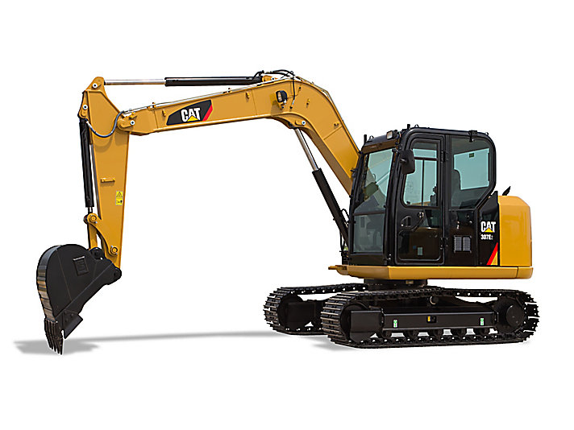
Introduction
Hydraulics are used when a high-force output is desired
Hydraulics are used in:
  Cranes
  Construction machinery
  Forklifts
  Brakes
  Car jacks
  Robotics
Sultan Alenezi
Figure 1: Excavator hydraulic system [1]
Notes:
Hydraulics are used to apply large forces to objects.

Slide 3
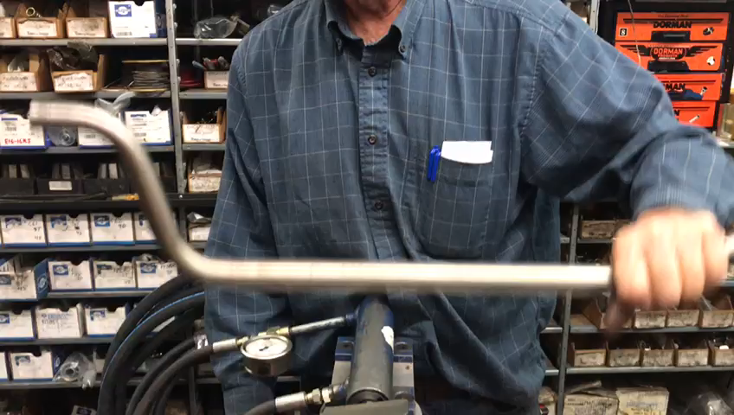
Introduction

Slide 4
Introduction
Advantages of hydraulics:
Multiply forces without the need for gears or lever arms
Maintain force constant without any energy input
Simple parts make it less expensive than electrical systems
Sultan Alenezi
Notes:
2nd bullet: With the control valve closed, the piston will not move even when a force is applied.

Slide 5
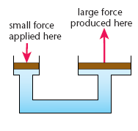
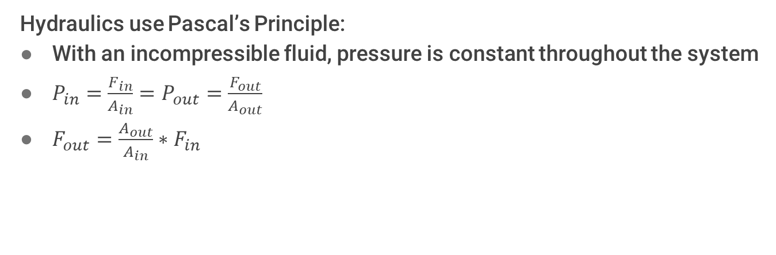
Background
Hydraulics use Pascal’s Principle:
With an incompressible fluid, pressure is constant throughout the system
$P_{in}=\frac{F_{in}}{A_{in}}=P_{out}=\frac{F_{out}}{A_{out}}$
$F_{out}=\frac{A_{out}}{A_{in}}∗F_{in}$
Cal Skilsky
Figure 2: Pascal’s Principle [2]

Slide 6
Project Description
Create a hydraulics demonstration unit to be used in thermal fluids lab
  Include a pump, a pressure-safety valve (PSV), a control valve, and an actuator
Measure the force and pressure throughout the system
Write an instruction manual and a lab procedure
Sultan Alenezi
Notes:
This unit

Slide 7
Design Requirements
Table 1: Design Requirements
Requirement | Measurement | Purpose
Maximum force output | 800 lb – 1300 lb | Safety
Stroke length | 6 in | Portability
Maximum pressure in actuator | 500 psi | Safety
Number of levers to operate system | 1 | Ease of use
Number of pressure gauges | 3 | Ease of use
Mosaed Aljebly

Slide 8
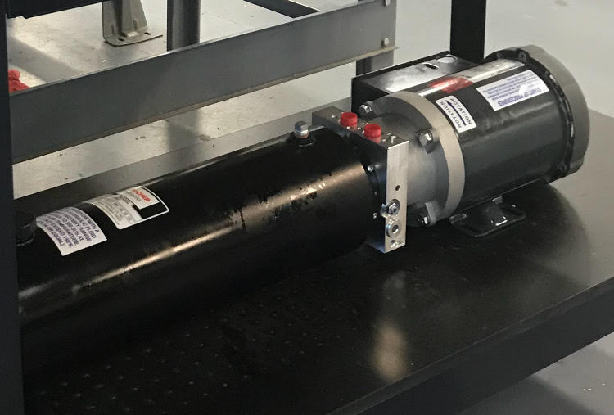
Design Description
Power Unit: Bucher
Pump: 2000 psi, 1 GPM
Motor: 1.5 HP, 3450 RPM
Reservoir: 2 Gal
Mosaed Aljebly
Figure 3: Bucher Power Unit [3]
Notes:
These values are within our design requirements

Slide 9
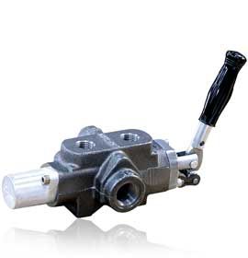
Design Description
Control Valve: CVA 200
4 way valve
Built-in pressure relief valve (set at 400 psi and 10 GPM)
Single lever proportional valve
Fawaz Alenezi
Figure 4: CVA Control Valve [4]
Notes:
Has an inlet port from the pump, an outlet port to the reservoir, and 2 ports to each side of the actuator

Slide 10
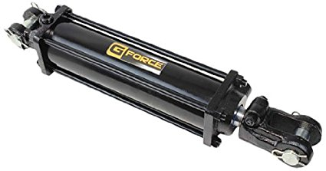
Design Description
Actuator: G-Force
2 in bore x 6 in stroke
Double acting
Piston area = π(2/2 in)^2 = 3.1 in^2
Force output = piston area * pressure = 3.1 in^2 * 400 psi = 1,240 lb
Figure 5: G-Force Actuator [5]
Cal Skilsky

Slide 11
Design Description
Hoses and connectors: Auto Valve
4 hoses at different lengths
8 connectors: power unit to control valve to actuator
Hydraulic fluid: Super S
1 Gal
High bulk modulus
Moderate viscosity
Mosaed Aljebly
Notes:
2 hoses connect the control valve to the power unit, and 2 hoses connect the control valve to the actuator
2 connectors at the actuator, 2 connectors at the power unit, and 4 connectors at the control valve
High bulk modulus means the fluid has a low compressibility
A moderate viscosity will allow for good mechanical efficiency and less wear on the components

Slide 12
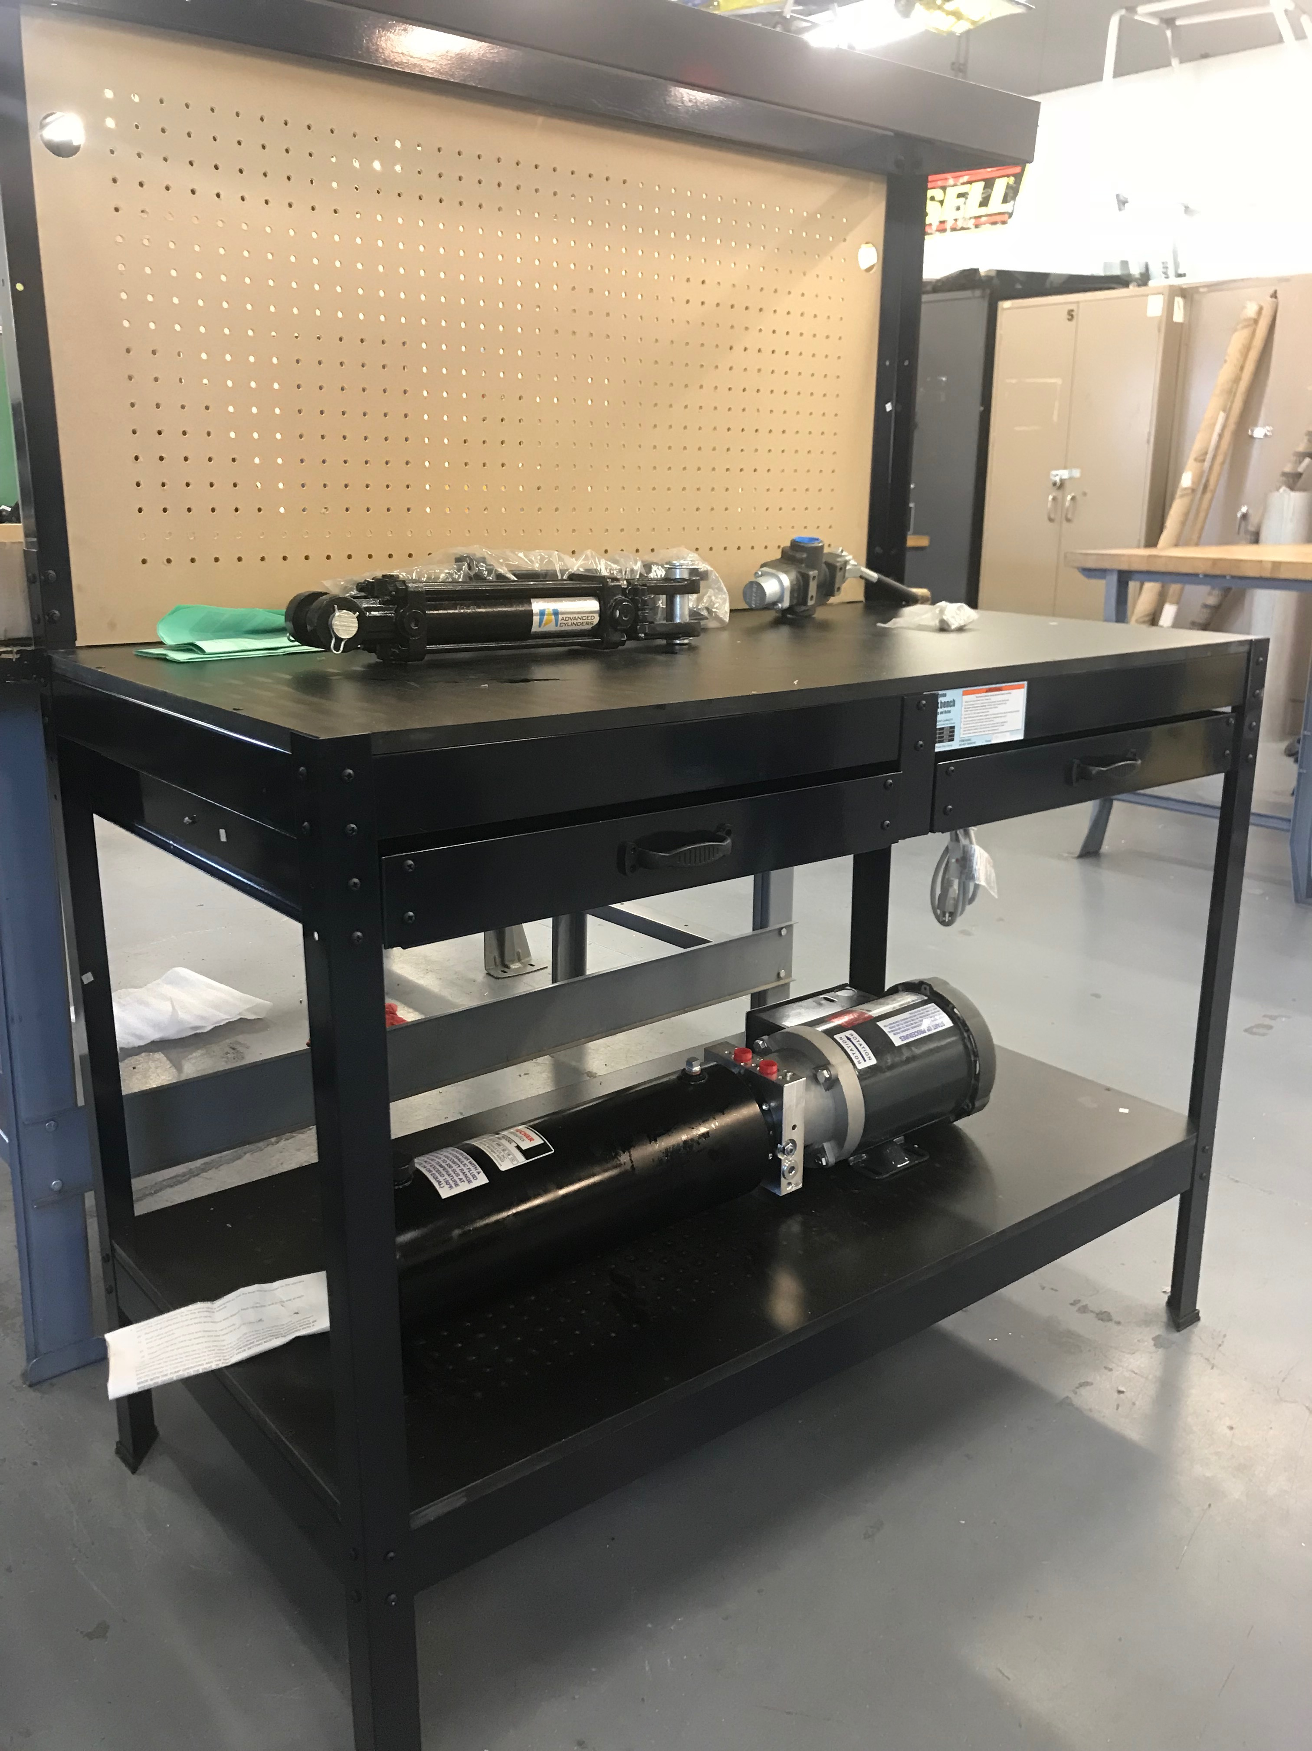
Design Description
Table: US General
Vertical pegboard
2 platforms
Power unit on lower platform
Actuator and control valve on upper platform
Mosaed Aljebly
Figure 6: US General table [6]

Slide 13
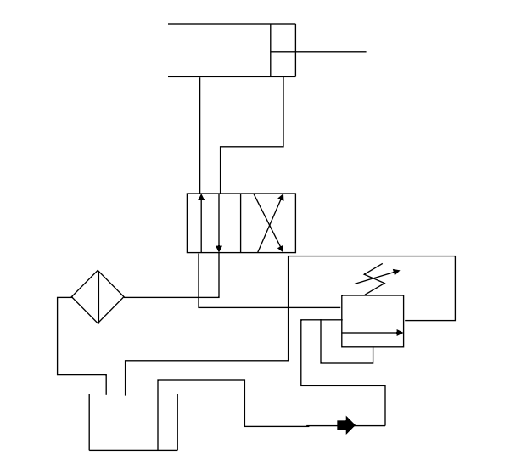
Design Description
Hydraulic Circuit for Double Acting Actuator:
Actuator
Control valve
Pressure relief valve
Filter
Pump
Reservoir
Sultan Alenezi
Figure 7: Hydraulic Circuit Diagram

Slide 14
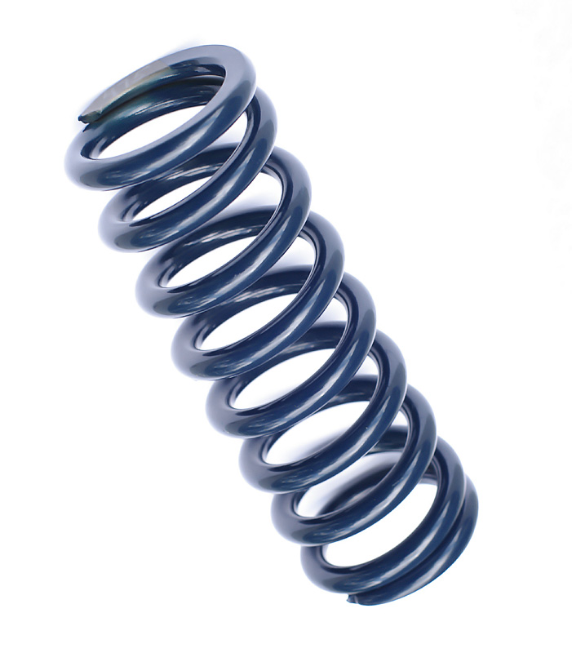

Design Description
To add force measurements to the system, a spring and Arduino are used:
Spring has known spring rate
Arduino measures the compression distance of the spring
Together, by multiplying these values, the force output can be calculated
Figure 8: Arduino Mega [7]
Cal Skilsky
Figure 9: Spring [8]

Slide 15
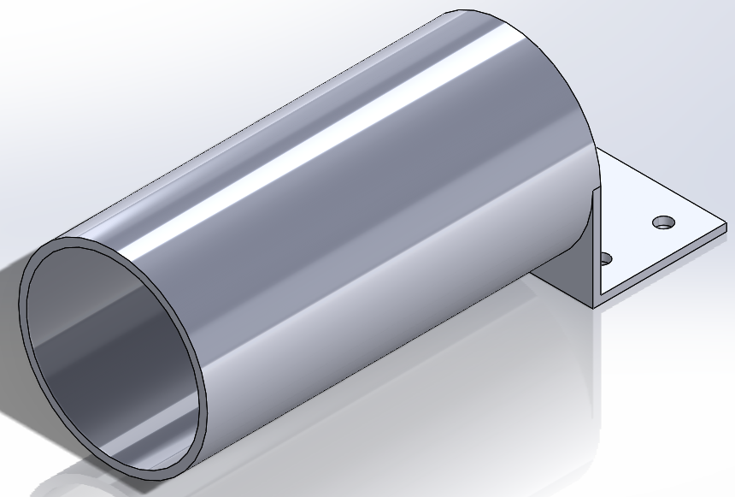
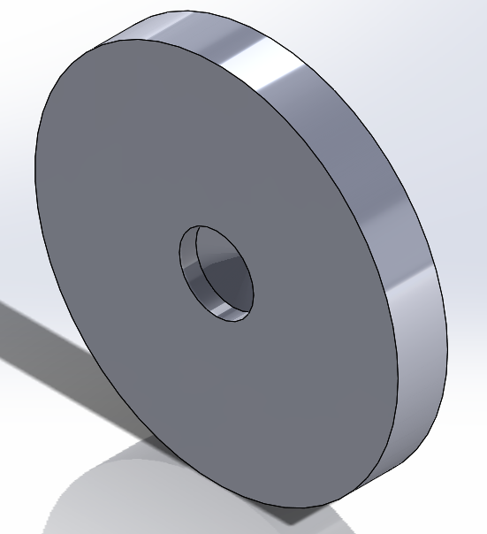
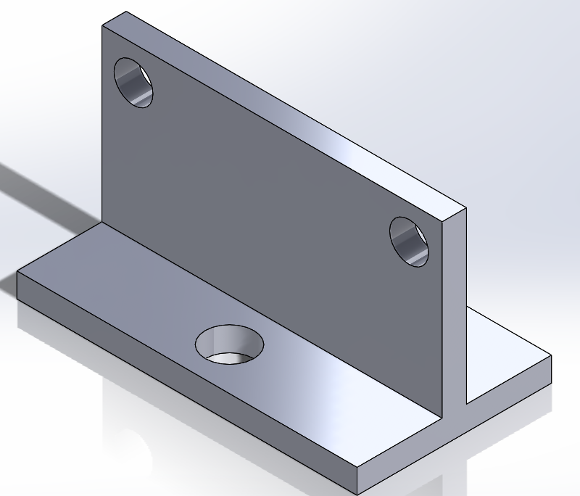
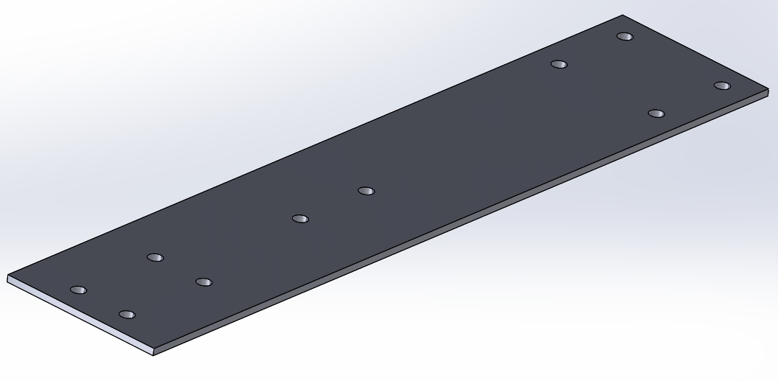
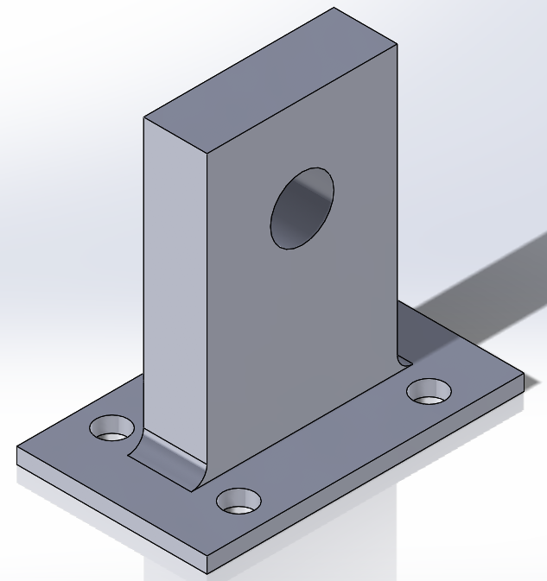
Design Description
Mounting brackets:
AISI 1020 steel
CNC machined
Cal Skilsky
Figure 10: Mounting brackets CAD models

Slide 16
Design Description
Experiments written in lab manual:
Relate pressure, piston area, and force at several points in the system
Determine the retracting force of the rod, knowing the piston diameter and rod diameter
Fawaz Alenezi
Notes:
If we know the piston area and the pressure (from the pressure gauge), we can calculate the force output. This can be checked by the measurements from the Arduino.
This is calculated by subtracting the area of the rod from the area of the piston and multiplying this value by the pressure.

Slide 17
Testing
System is assembled with proper hoses, connectors, and pressure gauges
Pump runs reversed
  Tried wiring both ways, but still runs reversed
  Possibly a manufacturing defect
Mounts are not yet machined due to time and budget constraints
  Spring and Arduino are currently unable to calculate force
Cal Skilsky

Slide 18
Knowledge learned
How an Arduino system works
How to bleed a hydraulic system
How to create hydraulic circuit diagrams
Fawaz Alenezi
Notes:
What makes a hydraulic system effective
How a spring and ultrasonic sensor can measure force
*An ardiuno works by sending ultrasonic waves to an object and back and measures the time it takes to complete this. By knowing how fast ultrasonic waves are, it can calculate the distance between the objects.

Slide 19
Conclusion
Uses power unit, control valve, and actuator
Spring and Arduino will calculate force output
Students complete lab experiments to learn fundamentals
Future work: add a single acting actuator and a double acting-double rod actuator
Fawaz Alenezi
Notes:
Our hydraulic demonstrator allows students to learn the fundamentals of hydraulic systems

Slide 20
References
[1] Cat Staff. “366F L Straight Boom” 2017. [online] Available: https://www.cat.com/en_US/products/new/equipment/excavators/demolition-excavators/1000028563.html [Accessed Apr. 23, 2018].
[2] Revision World Staff, “Pressure” 2013. [online]. Available: https://revisionworld.com/a2-level-level-revision/physics/force-motion/some-effects-forces/pressure [Accessed Feb. 8, 2018].
[3] Bucher Hydraulics Staff, “Hydraulic Power Packs” 2017. [online]. Available: https://www.bucherhydraulics.com/47809/Products/Mobile-and-Industrial- Hydraulics/Products/Power-Units/Hydraulic-Power-Packs,-Series-UP/index.aspx [Accessed Mar. 17, 2018].
[4] Hydraulic Controls Staff, “CVA-200 4 way valve” 2017. [online]. Available: http://www.hydraulic-controls.com/index.php/products/hydraulics/valves/spool/20039.html [Acccessed Apr. 24, 2018].
[5] Gforce Hydraulics Staff, “Tie Rod Hydraulic Cylinder” 2017. [online]. Available: http://gforcehydraulics.com/114012x6tierodcylinder [Accessed Nov. 7,2017].
[6] Harbor Freight Staff, “48 in Workbench with Light” 2017. [online]. Available: https://www.harborfreight.com/48-in-workbench-with-light-60723.html [Accessed Nov. 7, 2017].
[7] Arduino Staff, “Arduino Mega 2560” 2017. [online]. Available: https://store.arduino.cc/usa/arduino-mega-2560-rev3 [Accessed Apr. 4, 2018].
[8] On All Cylinders Staff, “Spring Training’ 2016. [online]. Available: http://www.onallcylinders.com/2015/09/03/spring-training-figuring-out-proper-coil-spring-rate-for-your- drag-car/ [Accessed Apr. 24, 2018].

Slide 21
Questions?

